Slide 1
Multivariate Analysis of Variance

Slide 2
Today . . .
  MANOVA as a way to reveal new information about group differences
  MANOVA as a way to overcome problems with a univariate approach

Slide 3
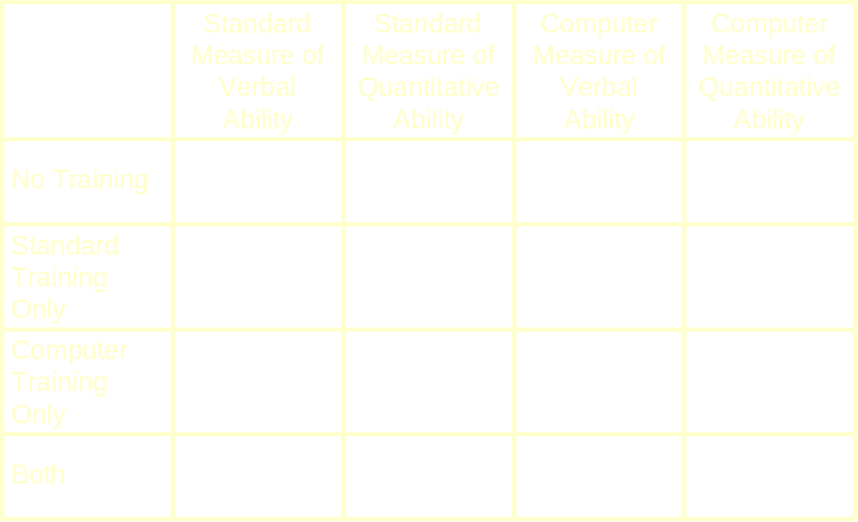
Within-Subjects
Between-Groups

Slide 4
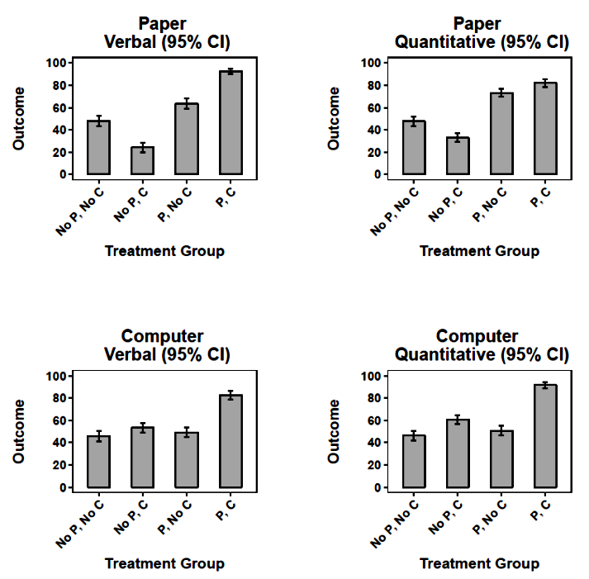
The four groups exhibited significant differences on each of the four measures.

Slide 5
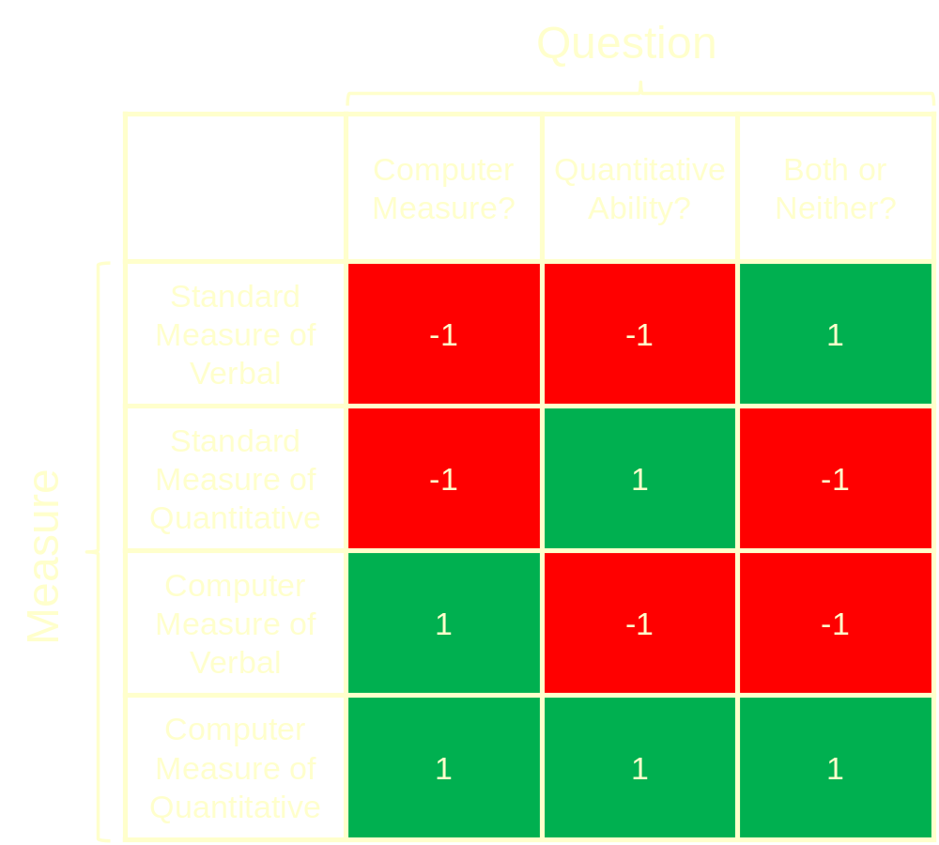
The factorial structure underlying the repeated measures represents one way to partition the variability in the repeated measures. It also represents a set of weighted linear combinations that
separate the groups. But are they the best linear combinations? Could a different set of weights do a better job?

Slide 6
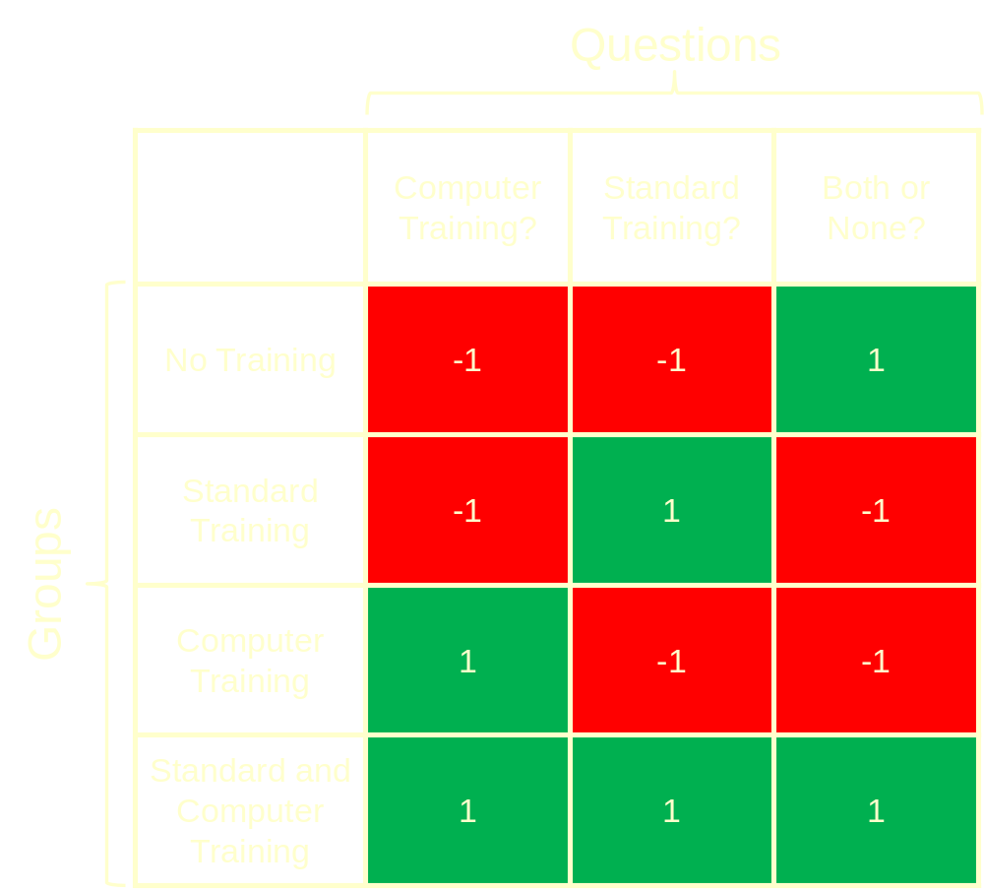
The factorial structure underlying the groups likewise partitions the variability in the group means. It also creates the simplest possible group distinctions—a set of independent two-group comparisons.
But, are these the most interesting comparisons? Could the groups differ in other important ways?

Slide 7
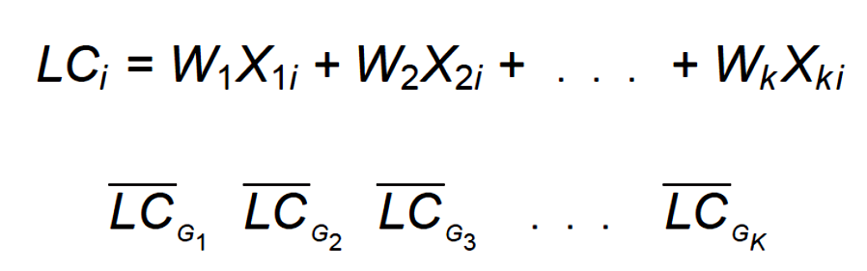
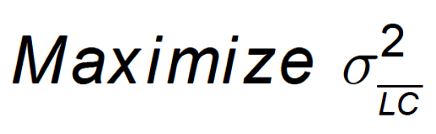
We could relax the factorial structure and ask, “Is there a linear combination of the outcomes that produces the best or maximum separation of the groups?”

Slide 8
Once that linear combination is found, is there another one—independent of the first one—that produces maximum separation of the groups?
Are there subsequent linear combinations, independent of previous ones, that provide maximum group separation?
A MANOVA (just a discriminant analysis) can answer these questions.

Slide 9
The simplest and least restrictive discriminant analysis imposes no structure on the groups and no structure on the measures. It represents a standard discriminant analysis applied to groups that happen to have been created by the researcher.
It is the most exploratory multivariate approach that we can take with these data, aimed at discovering (rather than imposing) how the groups can best be separated with weighted linear combinations of the measures. The candisc( ) function from the candisc package is particularly useful.

Slide 10
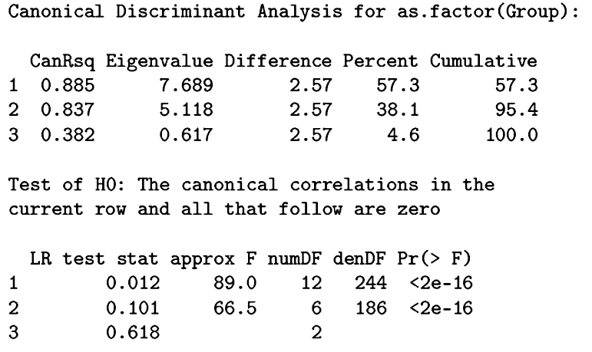
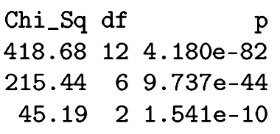
Three discriminant functions are possible with four groups and four measures; all three produce significant
discrimination among the groups. The first two account for 95% of the group separation.

Slide 11
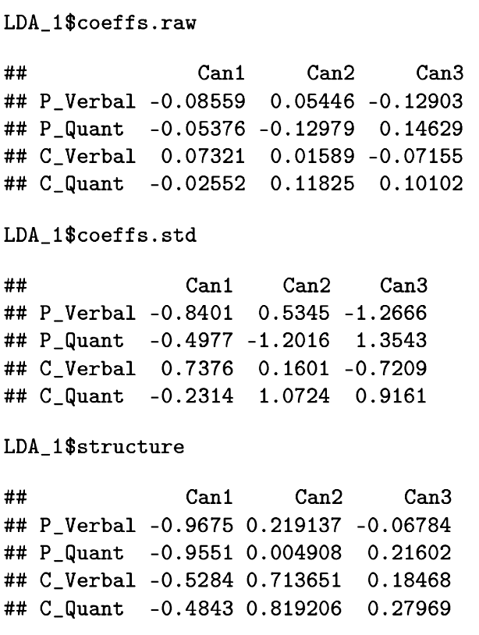
The raw coefficients are used to generate function scores. The standardized coefficients and structure coefficients (correlations) are used to determine the nature of the linear combinations.

Slide 12
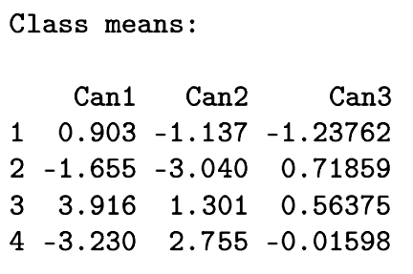
No P, No C
P, No C
No P, C
P, C
The first function is dominated by paper measures; the second is
dominated by computer measures. The first function has the greatest separation for the computer trained groups that differed in whether they received training with standard paper measures. The second function separates standard trained groups that differed in whether they received computer training.

Slide 13
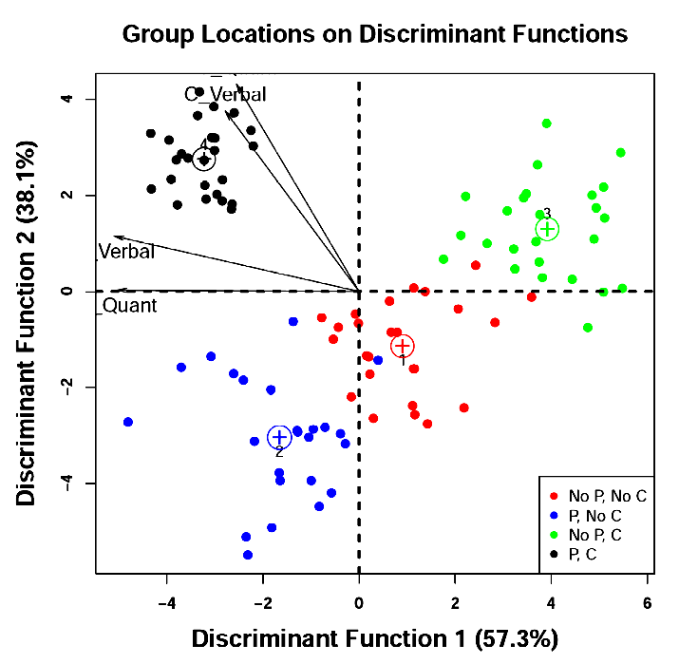

Slide 14
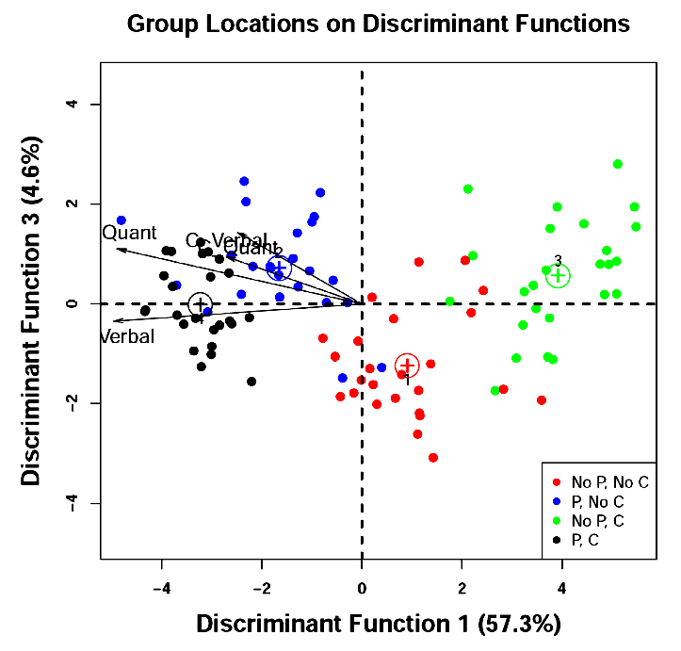

Slide 15
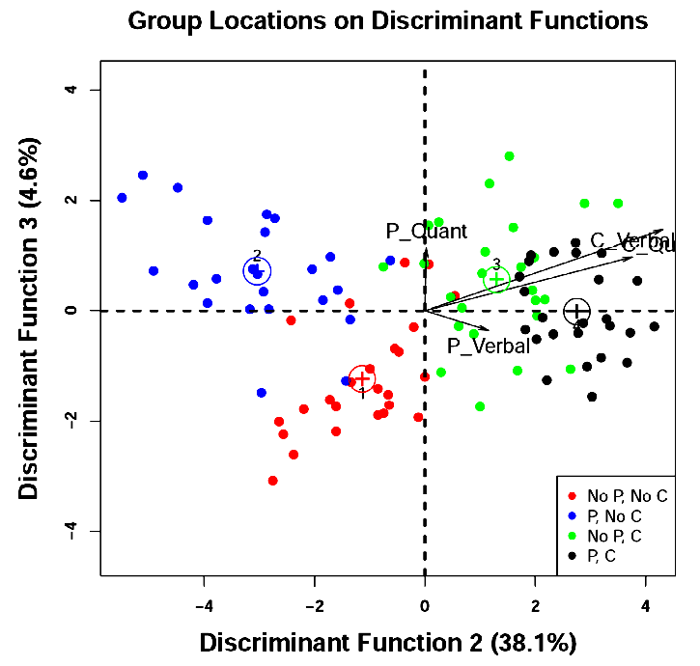

Slide 16
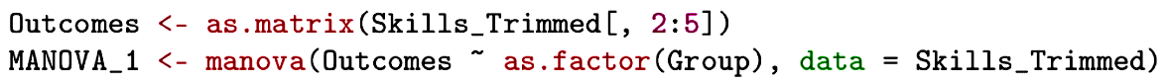
The manova( ) function from the stats package can provide some additional information. It provides the full set of significance tests as well as the sums of squares and cross-products matrices on which the tests are based.

Slide 17
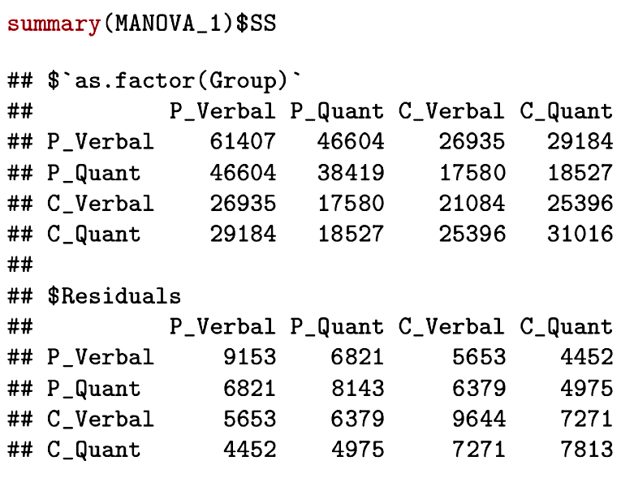
H (or B)
E (or W)
These are the two major matrices that are used in the calculation of the significance tests.

Slide 18
Different combinations of H and E define the four most common tests of significance:
  Wilk’s likelihood test is based on Λ = |E|/|H+E|
  Pillai’s Trace is a function of tr(H[H+E]⁻¹)
  Lawley and Hotelling’s Trace = tr(HE⁻¹)
  Roy’s test is a function of the largest eigenvalue of HE⁻¹
The first three usually agree because they use much the same information.

Slide 19
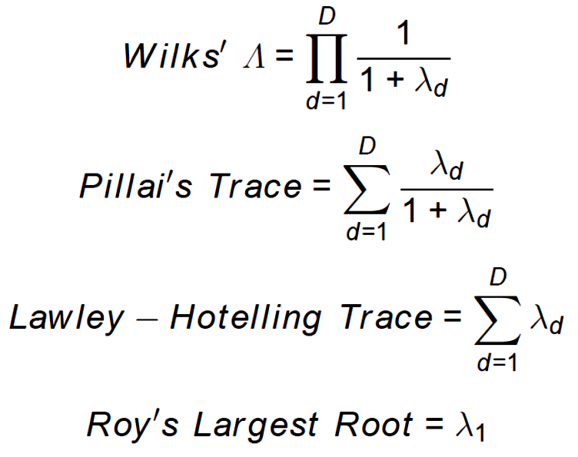
The four can also be defined in terms of the eigenvalues:

Slide 20
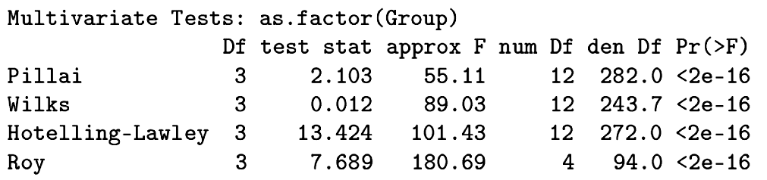
The Manova( ) function (note capitalization) from the car package allows specifying Type II or Type III sums of squares. That is not useful here with group unstructured, but could be important in unbalanced designs. This function also provides the sums of squares and cross-products matrices and all four significance tests.

Slide 21
The discriminant analysis can also be performed on "groups" defined by user-chosen weights. These might represent a factorial structure or other comparisons of interest.
Here we use the original factorial structure for the groups, but determine the weights that best separate the groups defined by that structure. In this case, we isolate the main effect for standard paper-and-pencil training.

Slide 22


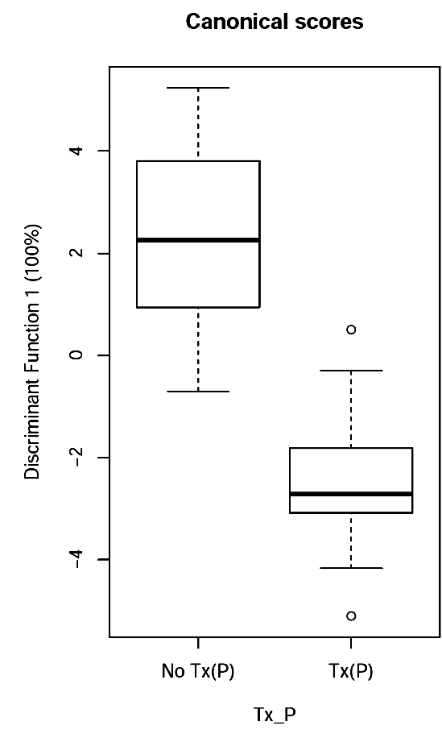
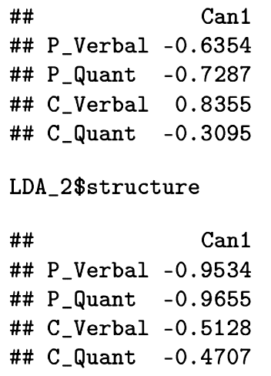
A significant separation of the two groups is possible and the linear combination is dominated by the paper measures.

Slide 23

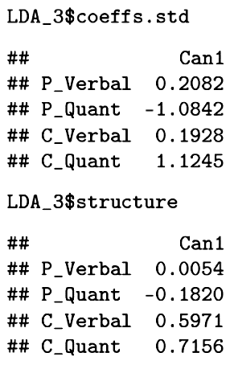
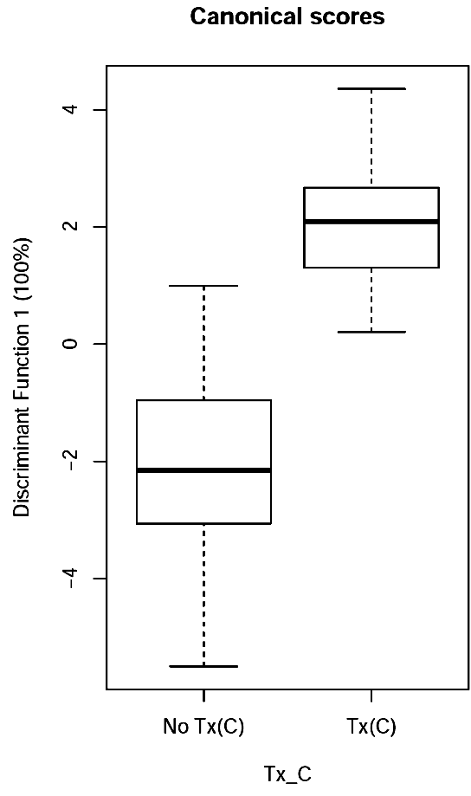
This analysis identifies the best way to separate the groups that either received computer training or not.
These groups can be significantly separated by a linear combination dominated by computer measures.

Slide 24
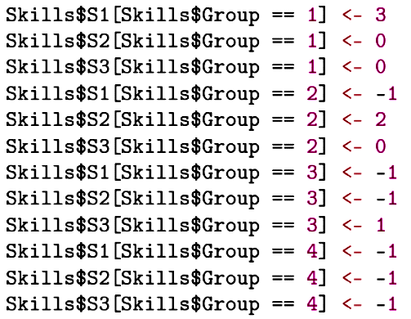
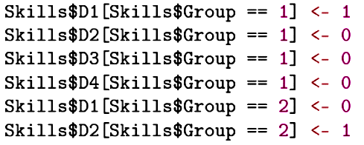
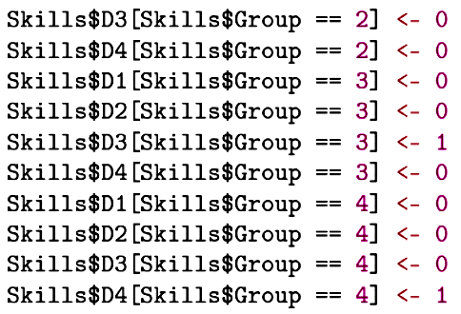
Other “groups” can be defined with special contrasts or dummy codes.

Slide 25
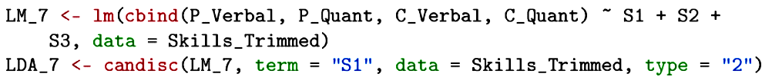

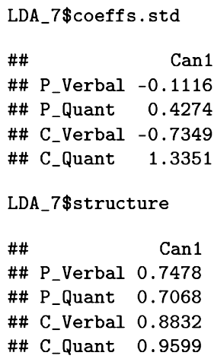
This analysis identifies the linear combination that best separates treated participants from the untreated controls.
Treatment of any kind improves performance, but especially on computer-based measures.

Slide 26
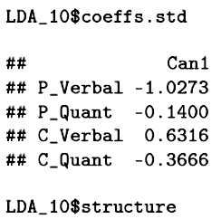

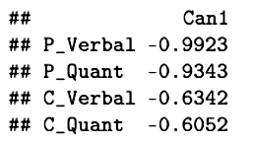
This analysis uses dummy codes with the reference group defined as participants who received both kinds of training. Here we identify the linear combination that best separates this
group from participants who
received computer training only.
The additional standard training for the reference group is apparent in the linear combination dominated by paper measures.

Slide 27
MANOVA (and discriminant analysis) has assumptions that need to be checked:
  Multivariate normality
  Homogeneity of variance-covariance matrices
  Absence of outliers

Slide 28
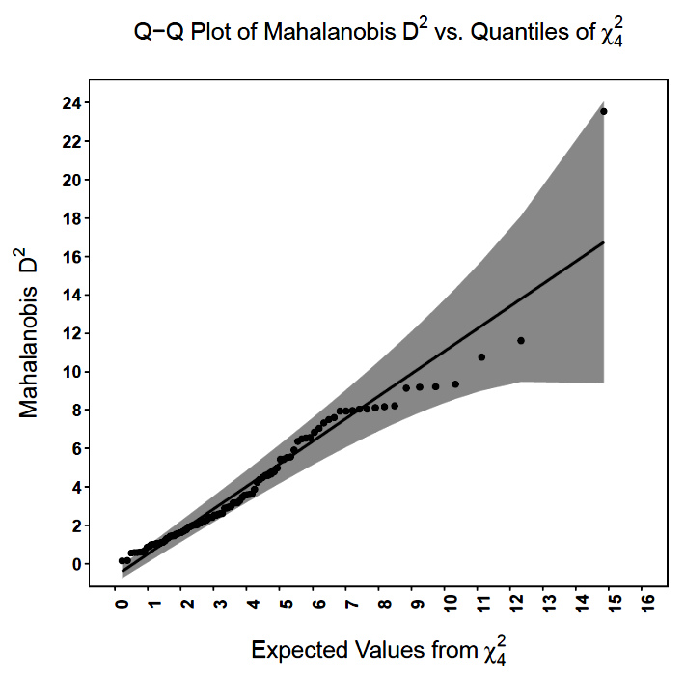
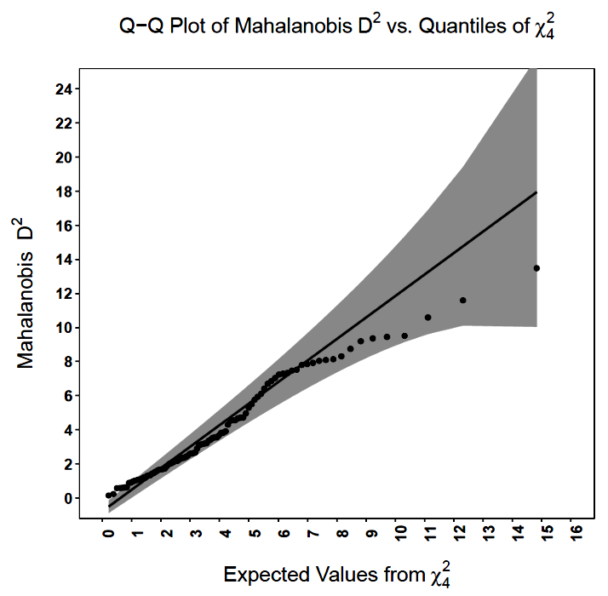
We eliminated a multivariate outlier.

Slide 29
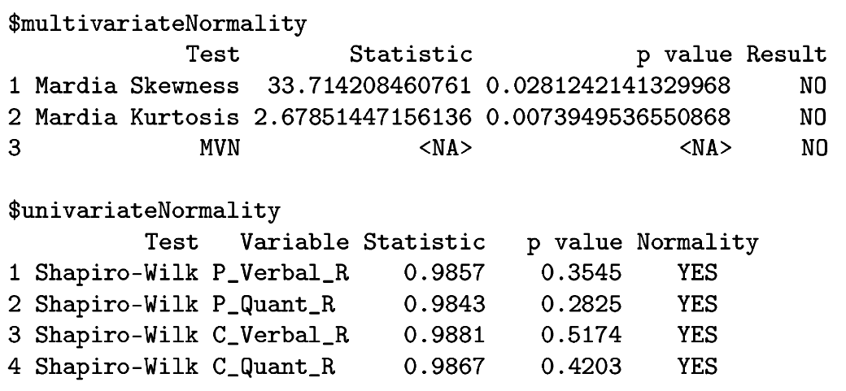
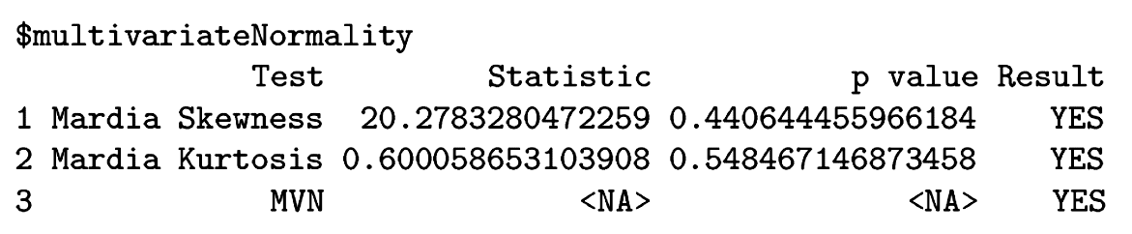
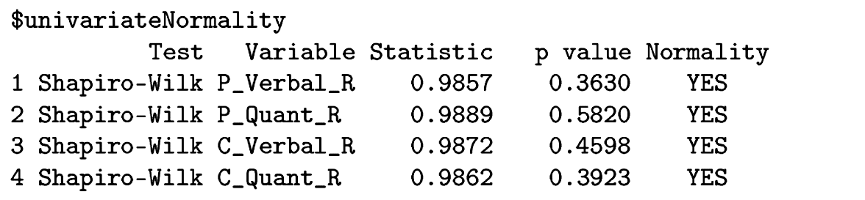
Outlier influence on normality:
Full sample
Outlier excluded

Slide 30
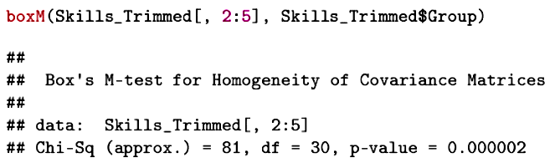
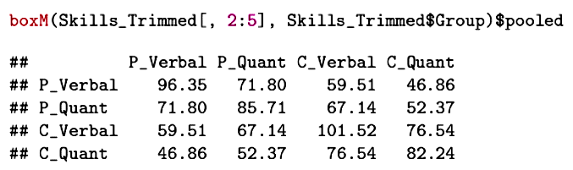
The homogeneity assumption fails, but this test is notoriously sensitive and MANOVA is generally robust to this violation, especially as sample size increases.

Slide 31
The multivariate approach can add to the univariate analyses by addressing some additional questions.
  With multiple outcomes, there is a danger of redundant findings. Which outcomes are most important? Do all add to the analyses in a meaningful way?
  Repeated measures ANOVA assumes sphericity. If this assumption is not met, the Type I error rate could be inflated. One remedy is adjustment of the degrees of freedom. Another is MANOVA, which does not have a sphericity assumption.

Slide 32
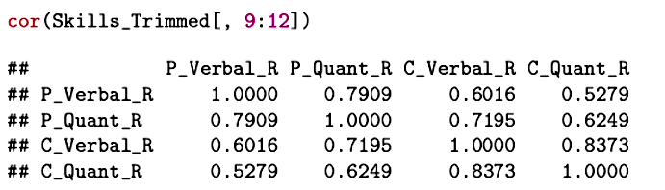
The multiple outcomes are highly related, especially the different abilities measured by the same method. These correlations underscore the redundancy in multiple univariate tests. MANOVA can determine how many independent ways the groups can actually be distinguished.

Slide 33
MANOVA is sometimes used to justify the individual ANOVAs. The rationale for using this omnibus test as a Type I error protection approach is that included among the possible linear combinations are those in which each outcome variable is the only variable receiving a weight.

Slide 34
The redundancy question can also be addressed using the Roy-Bargman step-down procedure. The dependent variables are tested in a univariate fashion, with other dependent variables used as covariates in an analysis of a target dependent variables.
Dependent variables that significantly distinguish groups after controlling for other dependent variables are adding uniquely to group differentiation.

Slide 35
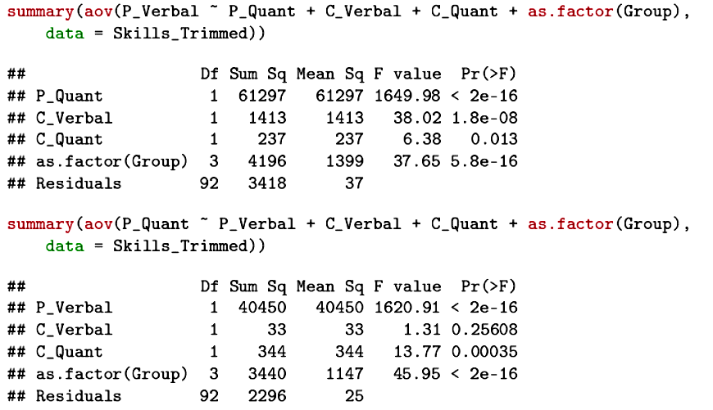

Slide 36
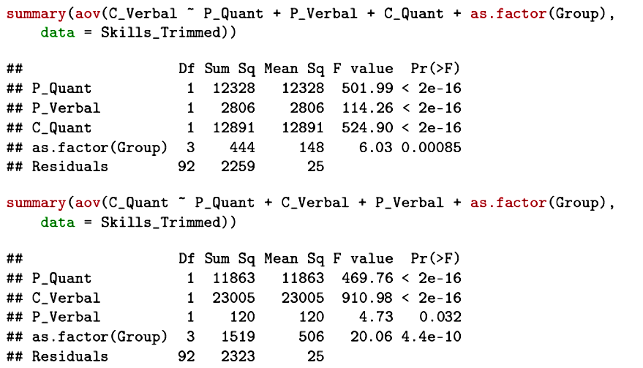
Each outcome measure has a unique contribution.

Slide 37
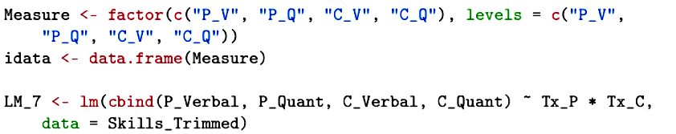

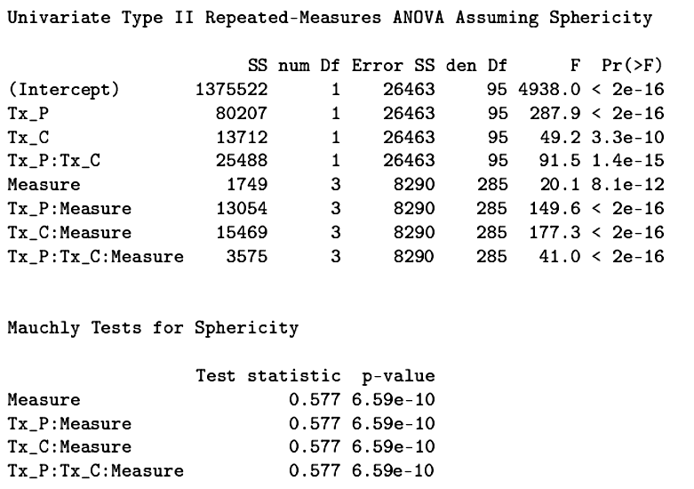
When the repeated measures have more than 1 df, sphericity becomes an important assumption.

Slide 38
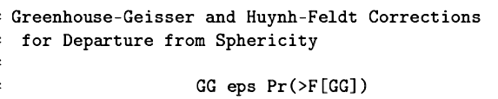
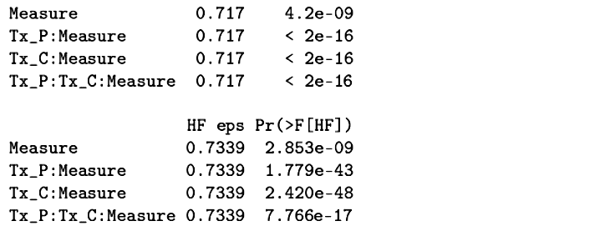
If sphericity fails, the F tests can be adjusted to be more conservative.
MANOVA is another solution.

Slide 39
Next time . . .
  Additional extensions and issues

